Slide 1

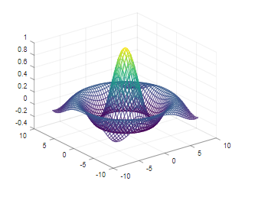
Learning Octave through Practicing
#001 – Opening and Octave Installation
GitHub: https://github.com/yasenstar/learn_octave

Slide 2
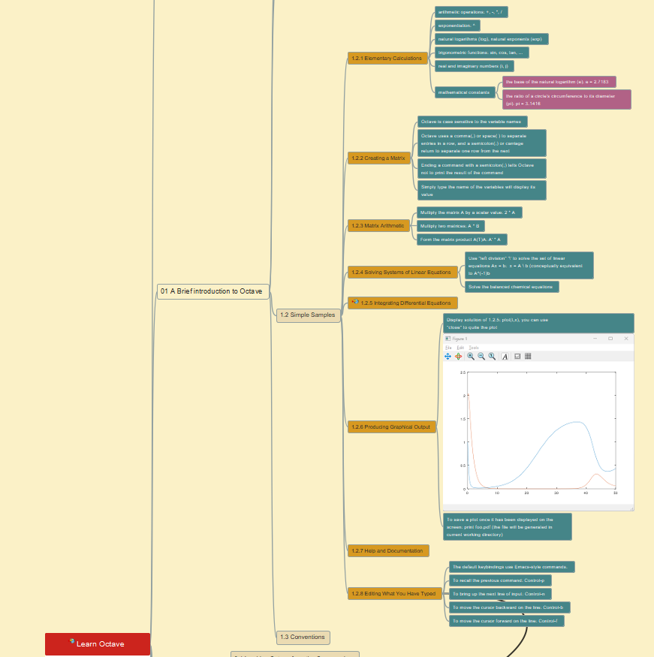
Learning Octave through Practicing
#002 – Simple Examples in Octave
GitHub: https://github.com/yasenstar/learn_octave

Slide 3
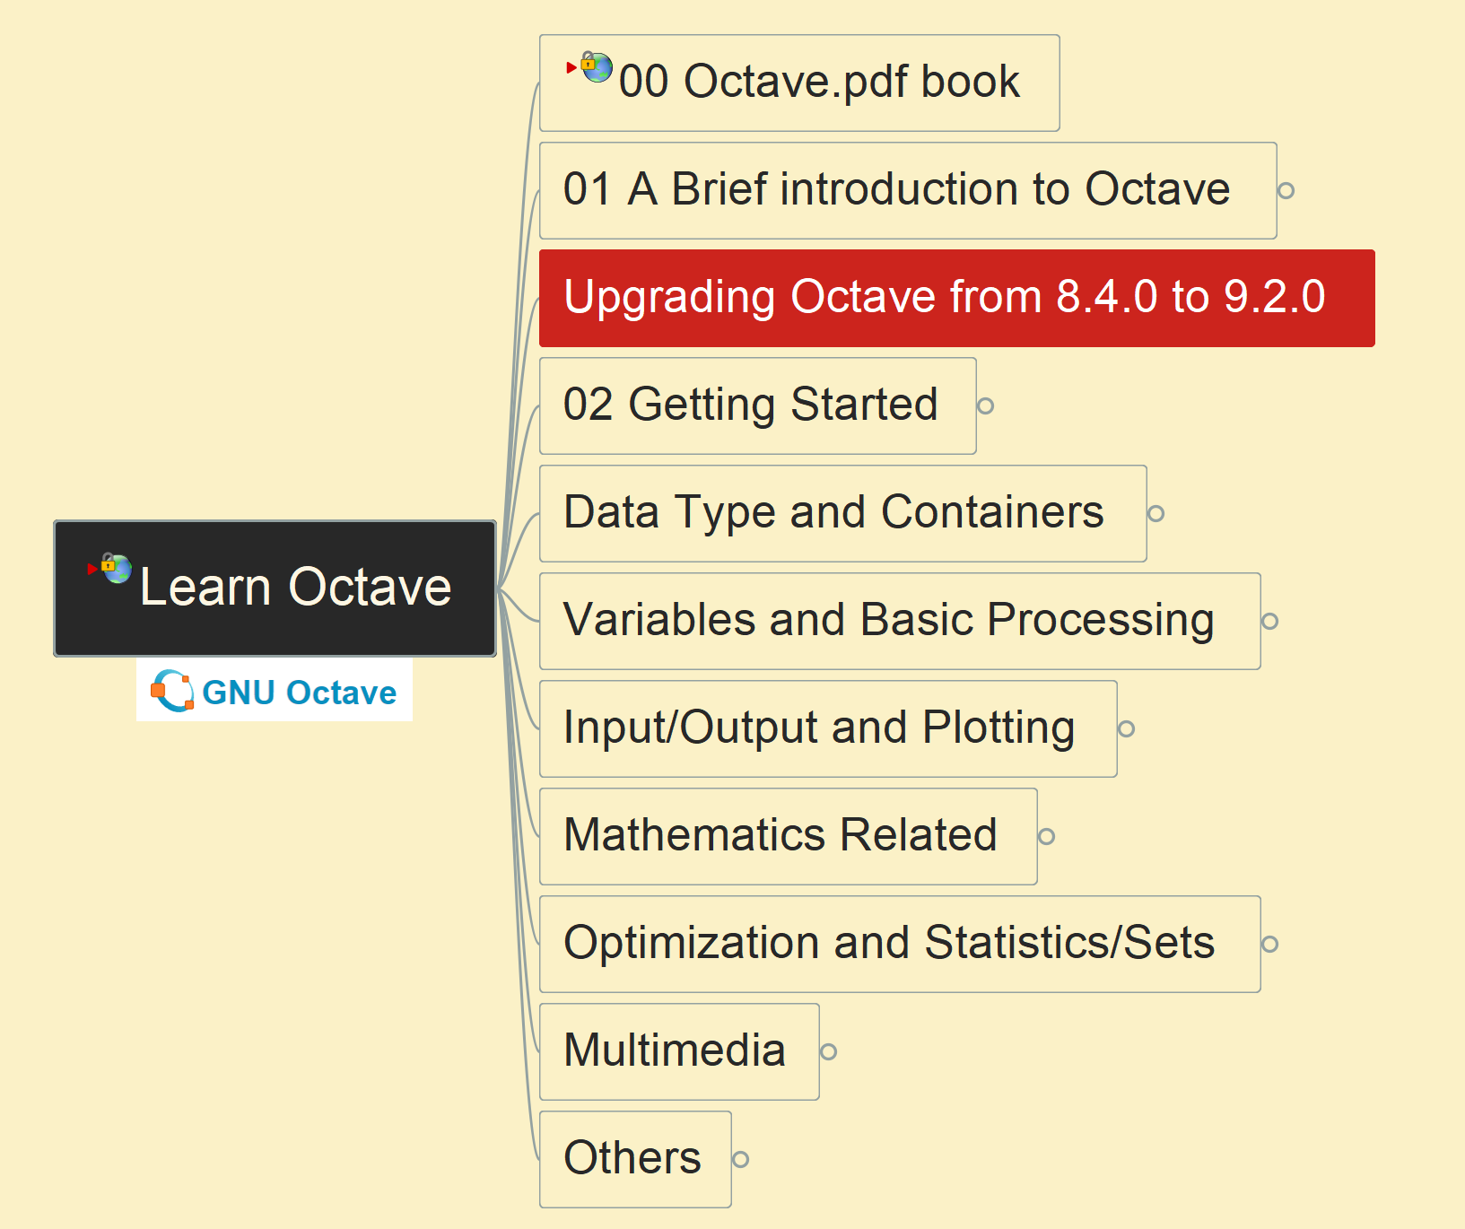
Learning Octave through Practicing
#003 – upgrade Octave
from 8.4.0 to 9.2.0
GitHub: https://github.com/yasenstar/learn_octave
Gitee Mirror: https://gitee.com/yasenstar/learn_octave

